Slide 1
Shiza eman
2025-GA-58
Abdul Mateen
2025-GA-29
Eshal Kashif
2025-GA-52
Mayeda Qamar
2025-GA-
Iffa Farhan
2025-GA-32han

Slide 2
Shiza eman
2025-GA-58
Abdul Mateen
2025-GA-29
Eshal Kashif
2025-GA-52
Mayeda Qamar
2025-GA-
Iffa Farhan
2025-GA-32han

Slide 3
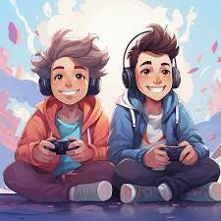
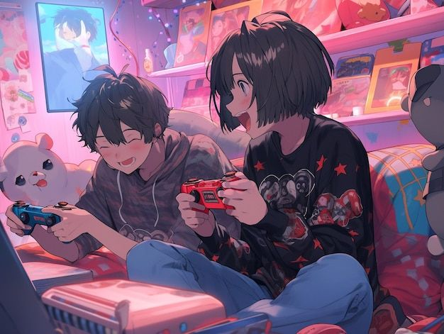
IMPACT OF GAME SOUND AND MUSIC ON USER EXPERIENCE

Slide 4


Introduction
Sound and music are powerful tools in video games.
They make games more realistic, emotional, and engaging.
Good sound design improves the overall player experience and connection to the game world.

Slide 5
Types of Game Audio
Sound Effects (SFX):
Actions like footsteps, gunshots, explosions, doors opening.
Provide feedback and realism.
2. Background Music (BGM):
Sets the tone or mood of a scene.
3. Voice and Dialogue:
Builds story and character emotions.
4. Ambient Sounds:
Background noises like wind, rain, crowd sounds – create atmosphere

Slide 6

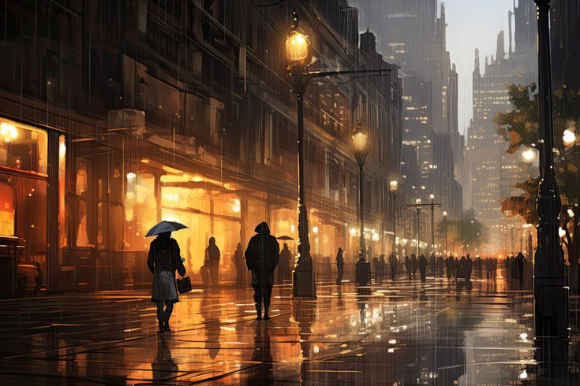
Emotional Impact :
Music and sound can change how players feel:
Fast tempo = excitement or tension.
Slow melody = sadness or calmness.

Slide 7

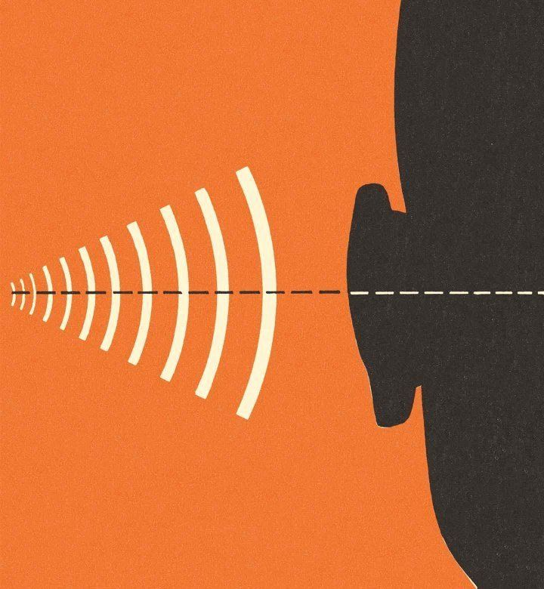
Annoying sounds when health is low.
Gameplay
Feedback
Level-up or achievement sounds.

Slide 8
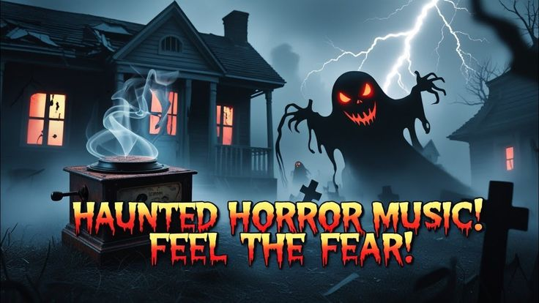

Case Studies
Horror Games:
Use eerie music and sudden sounds to build fear.
Adventure Games:
Calm background music enhances exploration.

Slide 9
Creates strong emotions that players want to experience again
Makes action more exciting, encouraging repeat play
Memorable music makes the scene stick in players’ minds
Perfect timing of sound effects gives satisfaction
Increases immersion, making players enjoy the scene more
--

Slide 11
Conclusion
Sound and music are not just extras – they are core parts of game design.
They affect how players feel, act, and remember the game.
A great game experience is both seen and heard.

